Slide 1
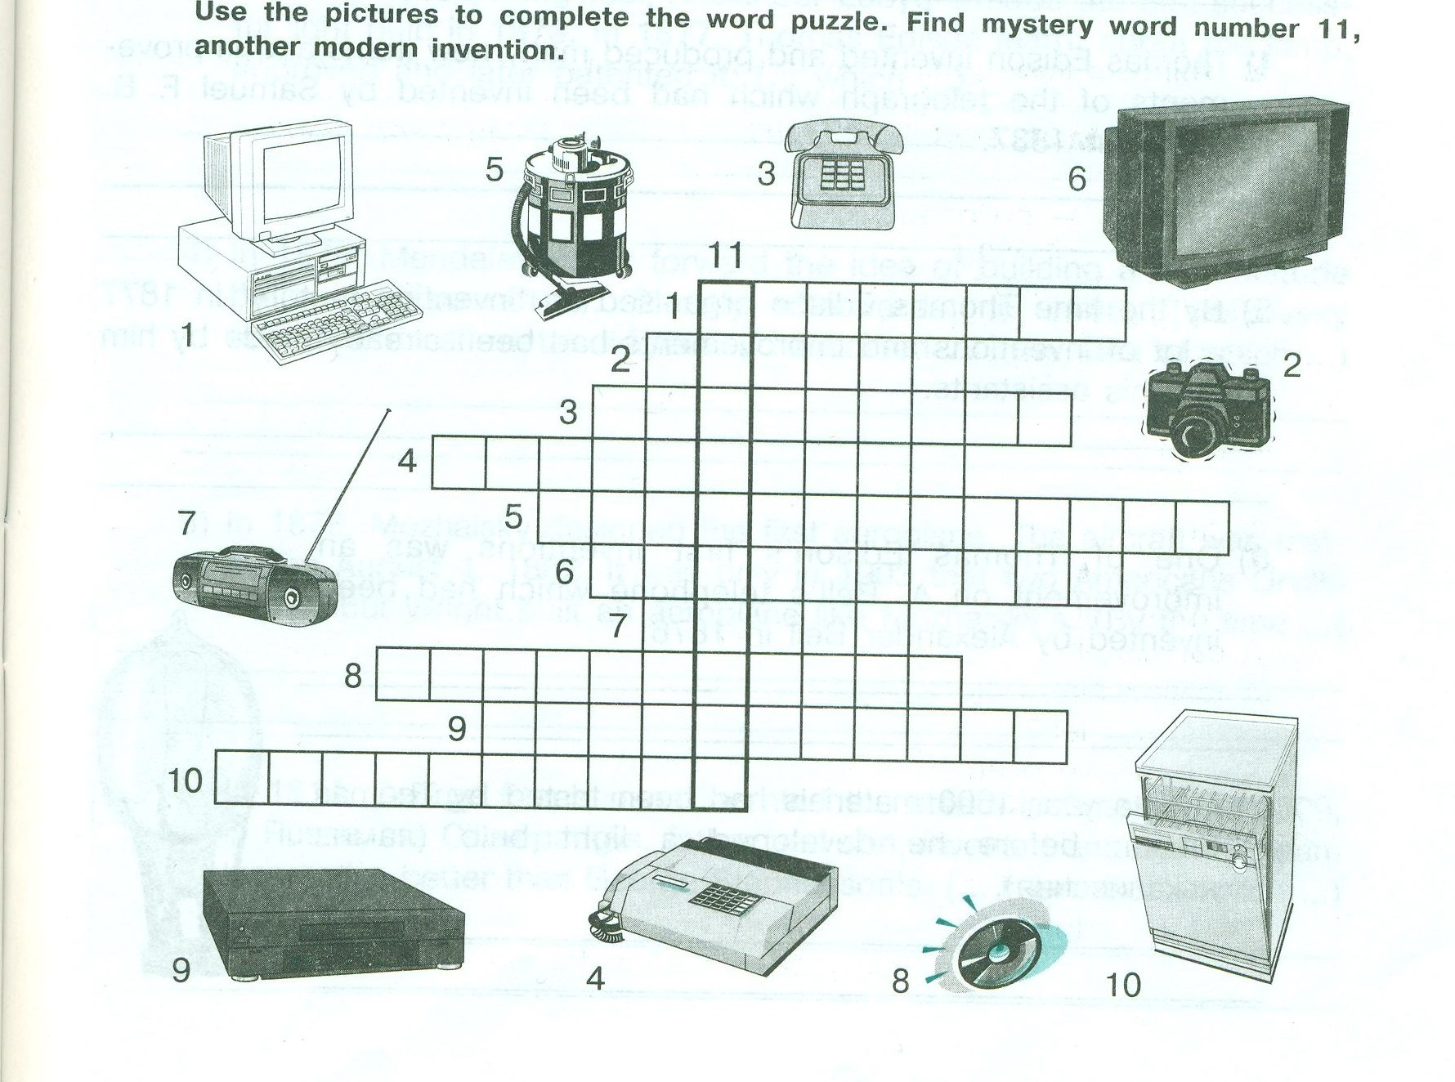

Slide 2
Modern inventions
1.Computer 6.Television
2.Camera 7.Radio
3.Telephone 8.Compact disc
4.Fax machine 9.Video player
5.Vacuun cleaner 10.Dishwasher
11.Calculator

Slide 3
Read the words
Match a word in A with the correct word in B.
А. B.
electric bike
portable CD player
exercise toothbrush
cassette cassette
notebook computer
facsimile system
video machine
mobile PC (personal computer)
audio and video player
personal telephone

Slide 4
Key
Match a word in A with the correct word in B.
А. B.
electrtic bike
portable CD player
exercise toothbrush
cassette cassette
notebook computer
facsimile system
video machine
mobile PC (personal computer)
audio and video player
personal telephone

Slide 5
Ask questions
1)Who was invented…?
2)In what country…invented?
3)When was…invented?

Slide 6

Listen and quess what gadgets are mentioned

Slide 7
Key
The first person is talking about a TV set and a TV remote-control unit.
The second person — a microwave oven
The third person — a mobile telephone
The fourth person — a videophone
The fifth person — a computer
The sixth person — roller blades

Slide 8
A Whole New World

Slide 9
Home task
Your home task will be
The first group: ex 3a,b p.ss4
The second group: ex4 p.ss4

Slide 10
Источники:
Spotlight 10: Teacher's Book
УМК. В. П. Кузовлев 10-11 класс, книга для учителя

